Slide 1


Happy PA Day!
April 14, 2026
How to Advocate For Your Career

Slide 2

Advocacy can seem daunting, but if you know where to look…

Slide 3


The future will seem much brighter!

Slide 4


Career Fairs
  Contact your school district administrators and ask about career fairs
  This can start the conversation early, before students choose their career path.
Notes:
Link to how to become a PA – AAPA https://www.pathassist.org/page/Become_PA

Slide 5


Guest Lectures – It Pays to Know
Contact your local high school or college administrators and offer to guest lecture in their classes.
  Anatomy
  Physiology
  Anything you feel comfortable with sharing from your knowledge!
Notes:
Link to poster and PA day https://www.pathassist.org/members/member_engagement/groups.aspx?code=PADay

Slide 6

Become a Clinical Site
  Check with your supervisor to verify if your workplace has the capabilities to host as a clinical site.
  Reach out to your local, upcoming, or alma mater PA program and inquire if they are interested in adding a clinical site.
  This could be a great recruitment method for your workplace!

Slide 7

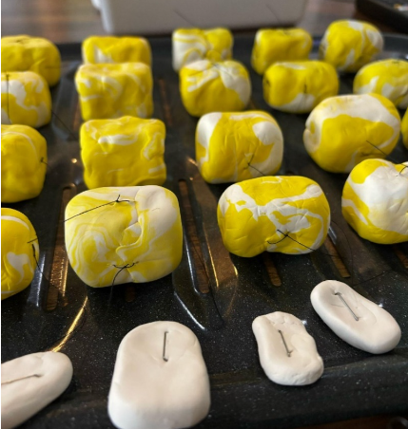
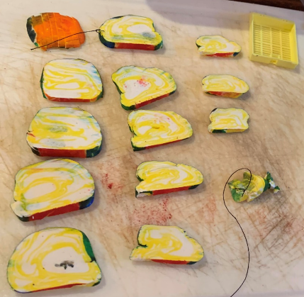
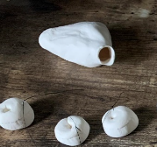
Clay Grossing
Purchase reusable model clay such as plasticine or Crayola Model Magic.
Make your own specimens to practice grossing with PA students, residents, or demonstrate grossing to grade schoolers interested in the career.
https://freebiesupply.com/logos/crayola-logo-3/
Photo credits to Lucie Bennett-Stein, PA(ASCP) and Taylor Treadway, PA(ASCP)

Slide 8


Advocacy Subcommittee
Reach out to info@pathassist.org to ask the subcommittee how else you can advocate!
Volunteer as a member of the committee.
  The AAPA offers multiple committees to share your knowledge and enthusiasm!
Notes:
Link to volunteer website https://www.pathassist.org/general/custom.asp?page=Volunteer

Slide 9

Attend Conferences
  Check out what other medicine-based conferences are out there besides the AAPA.
    e.g. National Association of Medical Examiners (NAME), American Academy of Forensic Sciences (AAFS), etc.
  Present a poster or give a talk.
  Volunteer to work the AAPA booth.
Notes:
Links to conference pages of professional societies

Slide 10

THANK YOU
Do you have any questions?
202.591.2478
info@pathassist.org
www.pathassist.org

